Slide 1





+1-855-SYNAPSE
+91-120-4290800
info@synapseindia.com
https://www.synapseindia.com/

Slide 2














Our Technology Partners
Memberships and Accreditations
+1-855-SYNAPSE
+91-120-4290800
info@synapseindia.com
https://www.synapseindia.com/

Slide 3
























Some of Our Clients
+1-855-SYNAPSE
+91-120-4290800
info@synapseindia.com
https://www.synapseindia.com/

Slide 4

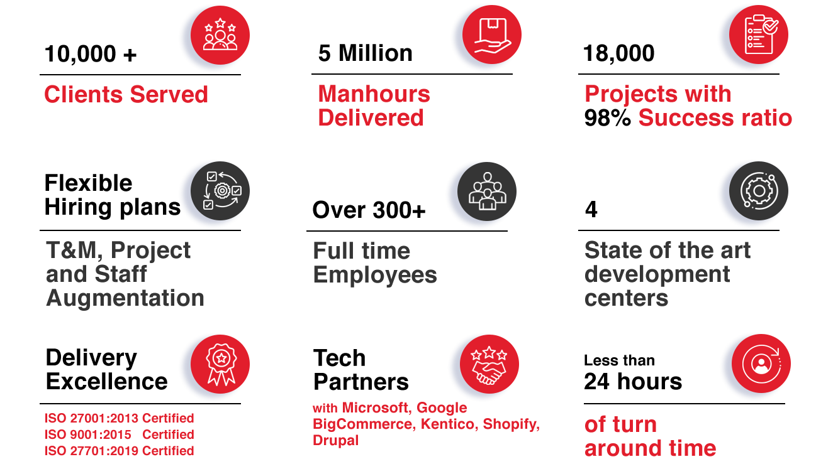
Why Partner with
+1-855-SYNAPSE
+91-120-4290800
info@synapseindia.com
https://www.synapseindia.com/

Slide 5
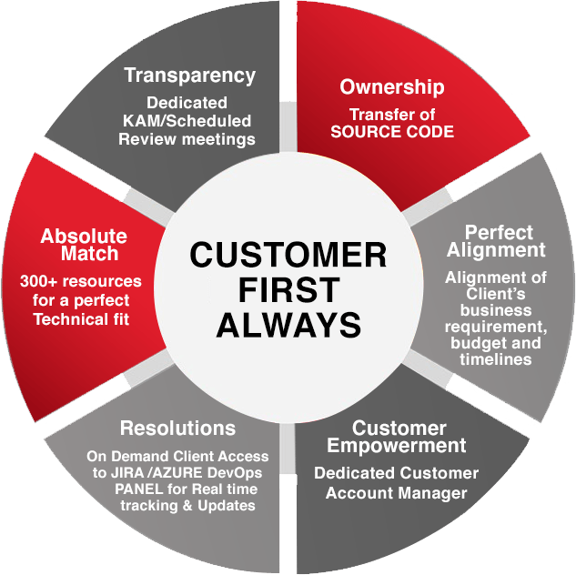
Customer First Approach
+1-855-SYNAPSE
+91-120-4290800
info@synapseindia.com
https://www.synapseindia.com/

Slide 6











Our Core Values
THINKING BEYOND
THE BOX
GOAL ORIENTED
I.T. Outsourcing @ Peace of Mind
03
DECISIVE
LOGICAL AND METICULOUS
Speed
Rapid Delivery
Reliability
Scale
Improved Collaboration
Security
+1-855-SYNAPSE
+91-120-4290800
info@synapseindia.com
https://www.synapseindia.com/

Slide 7












Enterprise Solutions Offered
One of the Pioneers driving Excellence towards Need Based Customized Enterprise solutions
4 Development centers driving R&D , Innovation & Technology Advancement: CMMI Level 3 compliant
  Ecommerce Development
  Mobile App
  Development
Web
Application Development
  Azure, Cognitive
  & Office 365
  Robotic
  Process
  Automation
  AI & ML
  Amazon Web Services
  SaaS Solutions
  CRM
  Solutions
  Digital
  Marketing
  CMS
  Solutions
  Cloud
  Solutions
+1-855-SYNAPSE
+91-120-4290800
info@synapseindia.com
https://www.synapseindia.com/

Slide 8




































Some Platforms We Support
+1-855-SYNAPSE
+91-120-4290800
info@synapseindia.com
https://www.synapseindia.com/

Slide 9
Case Studies
+1-855-SYNAPSE
+91-120-4290800
info@synapseindia.com
https://www.synapseindia.com/

Slide 10

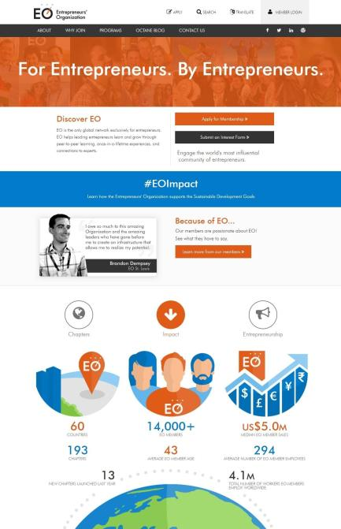
The EONetwork organization is comprises of Entrepreneurs only from across the globe. The organization has over 12,000 Entrepreneurs from 48 countries, has over 150 chapters with total sales of all EO members above USD 500 billion.
The portal has to offer a lot of features to Entrepreneurs: Network with other entrepreneurs across the globe, connect with chapters, chapter sub portal, pay for membership, view events across the globe, deals specific to EONetwork members, eLearning, etc. In addition to the portal, we have also developed iPhone and Android app for the portal.
Members of EONetwork include:
Michael Dell of Dell Technologies
Sarah Blakely of Spanx
- And 299 Entrepreneurs listed in INC 5,000 List
+1-855-SYNAPSE
+91-120-4290800
info@synapseindia.com
https://www.synapseindia.com/

Slide 11

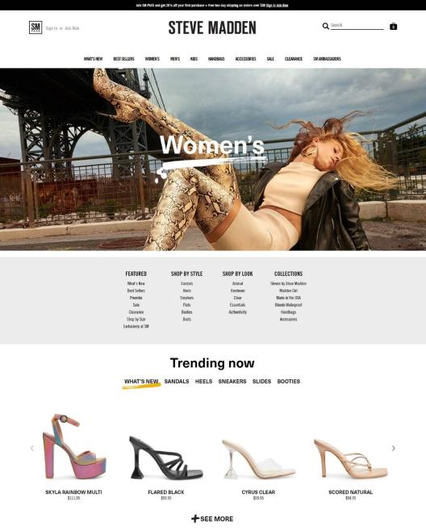
A popular & premium brand for footwear and accessories. We have developed the store from scratch and have integrated their Accounting, Inventory and other workflow systems for their US, South Africa, Australia, Canada and Mexico stores.
The team was very professional and I would 100% recommend it to anyone that looks for a solid partnership for their Ecommerce projects
- Steve Madden Team
+1-855-SYNAPSE
+91-120-4290800
info@synapseindia.com
https://www.synapseindia.com/

Slide 12




Catalog has more than 3 million book titles.
Physical books and e-books
Caters to B2B buyers and organizations with tiered pricing & preferred pricing.
Features also includes:
  Compare books
  E-books ordering
  Customized journals
  PO based ordering system with different payment terms
  Request for quote module
  Showcased on Magento.com
+1-855-SYNAPSE
+91-120-4290800
info@synapseindia.com
https://www.synapseindia.com/

Slide 13


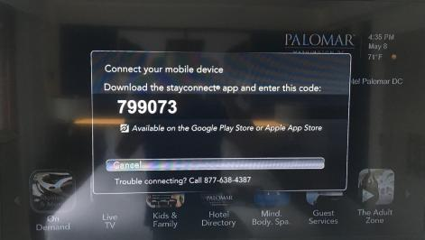
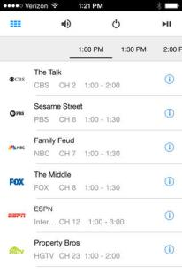
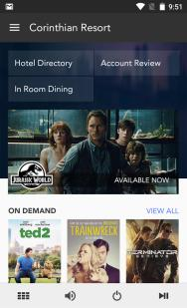
SONIFI’s integrated mobile applications gives guests of hotels the ability to discover content, hotel services and essential hotel information via their own mobile app or via SONIFI mobile app.
The app allows browse and purchase of content, access information about hotel services and amenities, request room service, housekeeping and other amenities, program guide and tune to channels on Room TV, control TV volume, power on/off, mute, pay for entertainment, group content: Content specific to the event can be embedded
+1-855-SYNAPSE
+91-120-4290800
info@synapseindia.com
https://www.synapseindia.com/

Slide 14
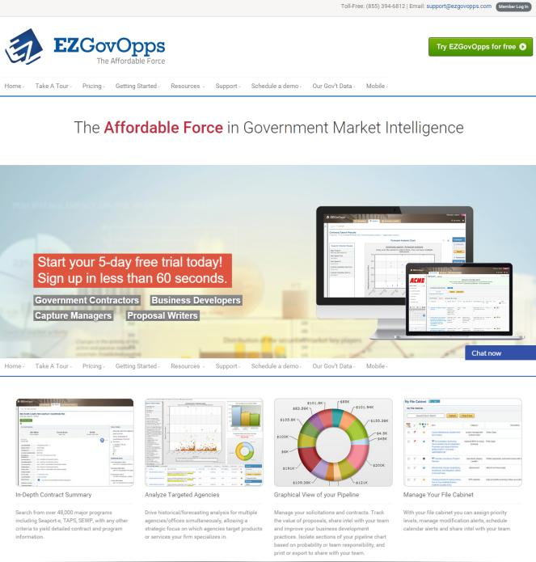

EZGovOpps is a very powerful Government Market Intelligence solution. The solution integrates many third party sources and presents information related to proposed/planned Government spending, past contract awards, RFP search, etc.
“The product is great! It has already paid for itself in the first year”
+1-855-SYNAPSE
+91-120-4290800
info@synapseindia.com
https://www.synapseindia.com/

Slide 15



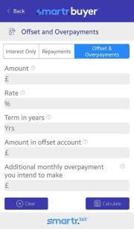
We have carried out the complete product development - web portal, five mobile apps for iPhone and Android for financial advisers and their clients.
The solution is currently being used by Two of the Big Four UK banks.
+1-855-SYNAPSE
+91-120-4290800
info@synapseindia.com
https://www.synapseindia.com/

Slide 16


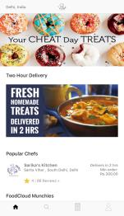
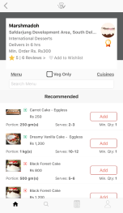


FoodCloud Website, iPhone & Android app connects foodies with home chefs and caterers in India.
Users are able to find and order
home-cooked food. The app allows users to choose from a variety of cuisines and menus and have orders to their doorstep.
Funding received from
&
Major Celebrities in India
+1-855-SYNAPSE
+91-120-4290800
info@synapseindia.com
https://www.synapseindia.com/

Slide 17


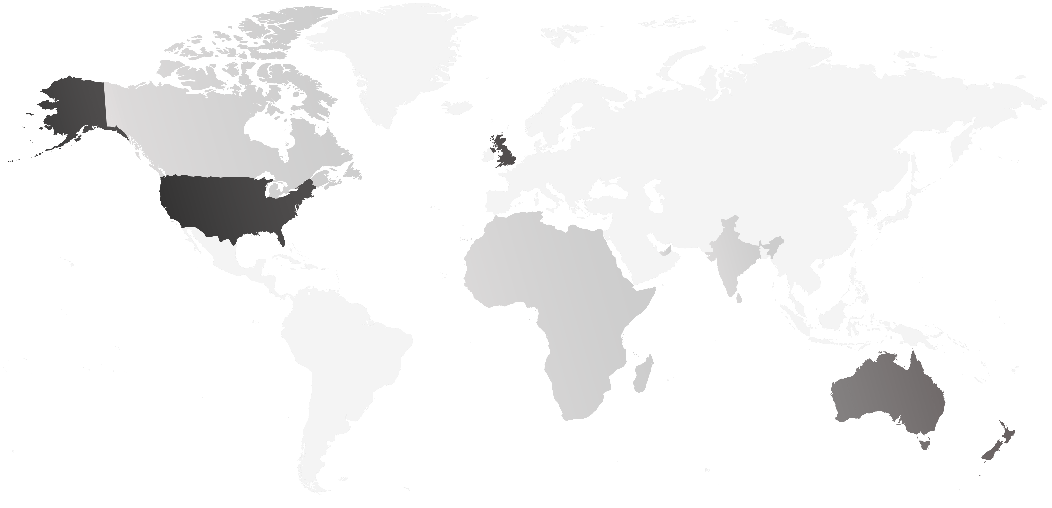













5 CONTINENTS , 50+ COUNTRIES,10K+ Clients and COUNTING
  Canada
  UK
  USA
  Africa
  UAE
  India
  Australia
  New Zealand
  USA – 75% Clients
  Australia and New Zealand – 10% Clients
  UK – 10% Clients
  UAE, Canada, India, Africa – 5% Clients
+1-855-SYNAPSE
+91-120-4290800
info@synapseindia.com
https://www.synapseindia.com/

Slide 18
Email : info@synapseindia.com
Website : www.synapseindia.com
+1-855-SYNAPSE
+91-120-4290800
info@synapseindia.com
https://www.synapseindia.com/

